Slide 1


Empower Your Security: A Beginners Guide to Threat Modeling

Slide 2
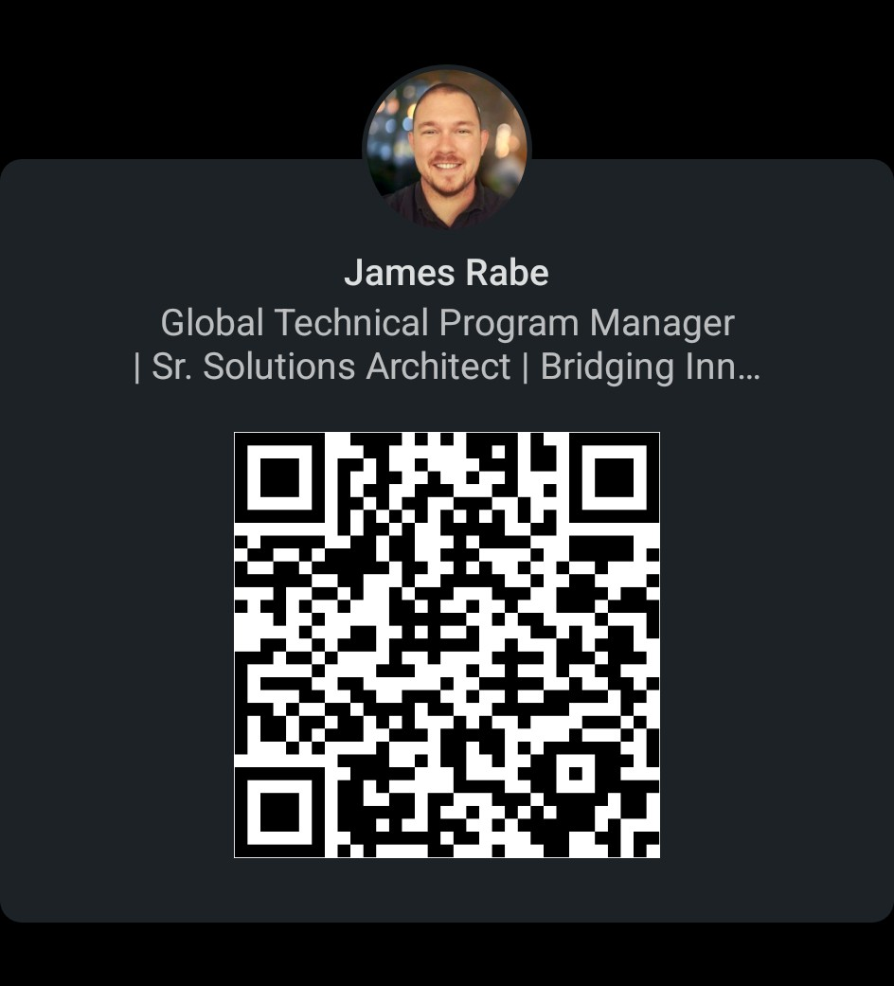

Bio
Threat Modeling, Cybersecurity
TMC - Founding Member
James Rabe
linkedin/in/jrabe3

Slide 3

Discussion Topics
What is Threat Modeling?
What are the benefits of Threat Modeling?
Threat Modeling Key Concepts

Slide 4
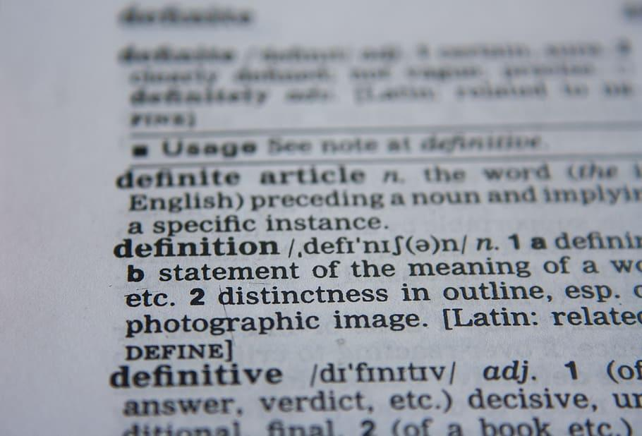
What is Threat Modeling?
Threat Modeling is a proactive assessment of risk which starts with a well scoped description of change and results in a prioritized list of realistic threats and prioritized set of cost-effective mitigations with a timeline and plan for risk reduction.

Slide 5
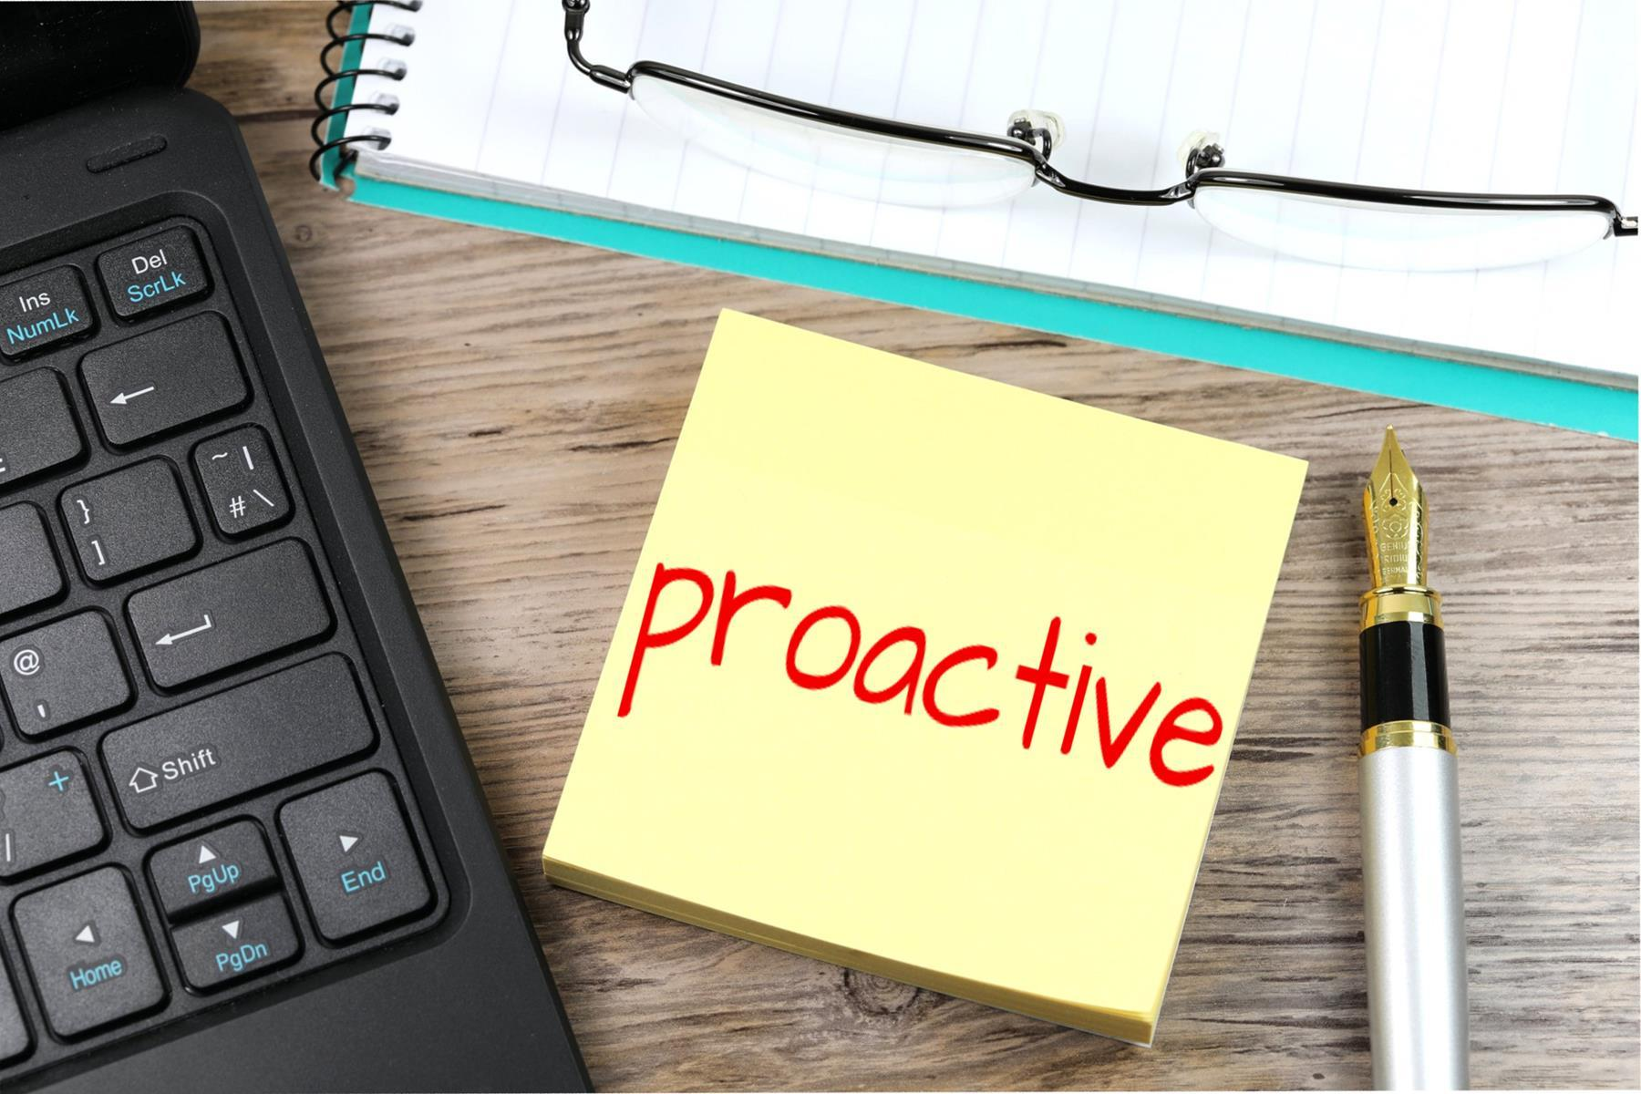
Breaking Down Threat Modeling
Proactive Assessment of Risk
Pre-Change Focused - Finding the problems as early as possible (design) vs finding them post implementation (production)
Problem Seeking - anticipating problems
Risk-Focused - organizational risk appetite

Slide 6
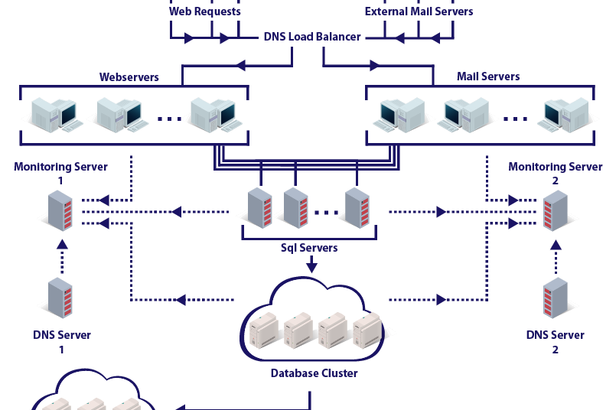
Breaking Down Threat Modeling
Well Scoped Definition of Change
Accurate Enough Description of the Change
Limited Scope to Prevent Over-Analysis
Diagram Based
Story Based
Should include what is not in scope

Slide 7

Breaking Down Threat Modeling
Prioritized List of Realistic Threats
Realistic Threat - Exploit likely threats
Prioritized
Enumerated and Cataloged
Tracked

Slide 8
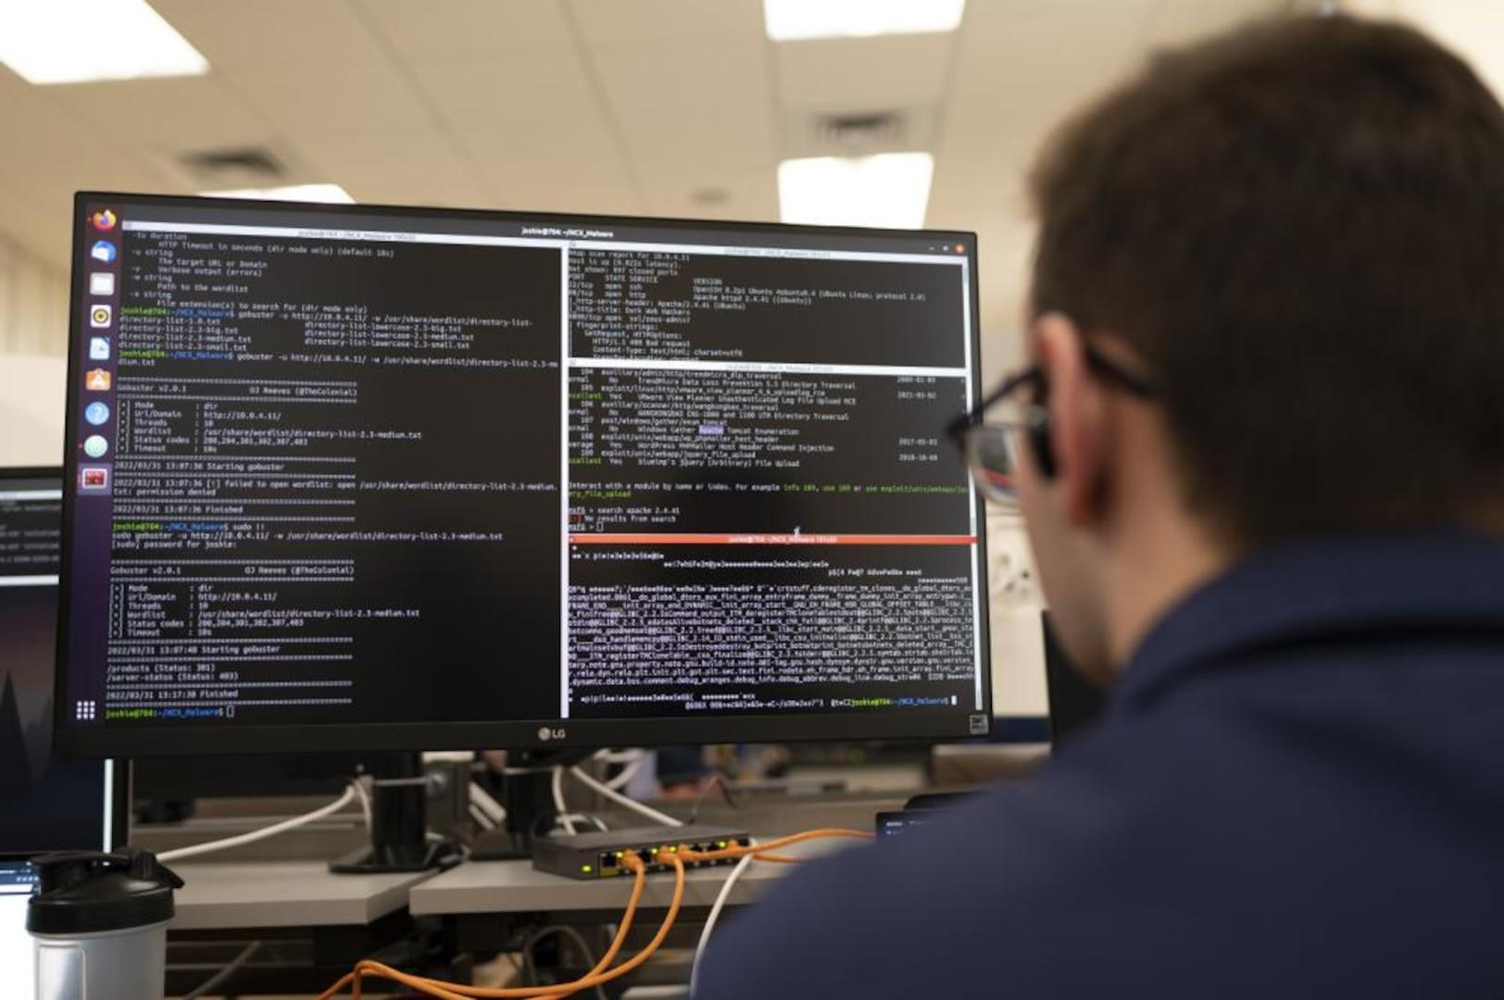
Breaking Down Threat Modeling
Prioritized List of Cost-Effective Mitigations
Mitigating Factors - Design Based or Corrective Based
Cost-Effective
Prioritized (not everything is urgent)

Slide 9
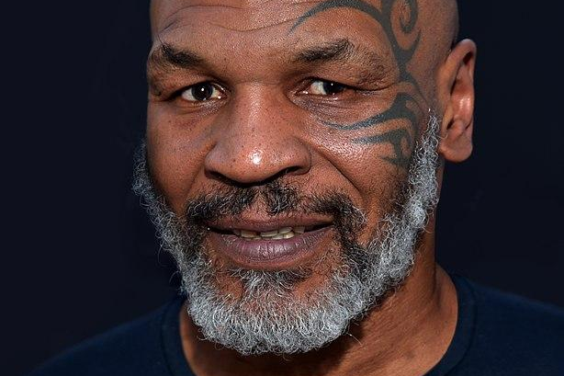
Breaking Down Threat Modeling
Timeline and Plan
Realistic & Flexible Timelines
Document dependencies
Barriers to success
Agile Milestones
Stakeholder Buy-in
Assigned and Responsible Personnel

Slide 10
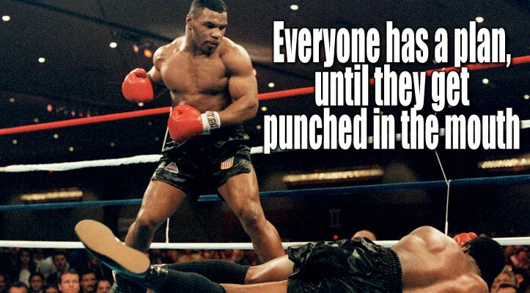

Slide 11
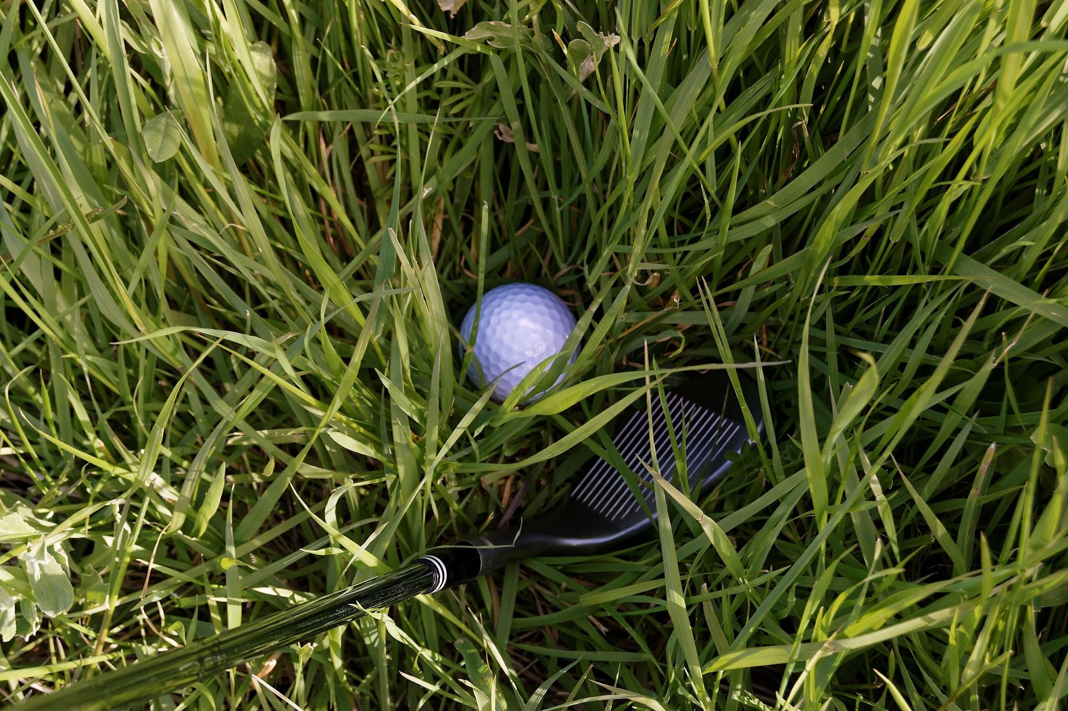
Breaking Down Threat Modeling
Risk Reduction
Threat Modeling should always result in a better risk position
Security (Aka Risk Management) is everyone’s job
Is the ball closer to the hole?

Slide 12
Threat Modeling Process
What are we working on?
What can go wrong?
What are we going to do about it?
Did we do a good job?
Scoping
Business Alignment
Threats
Mitigations

Slide 13
What are we working on?
Key Considerations for Scoping & Diagramming
Meaningful - Does it impact scope for this model?
Security Impacting - Does this representation impact security?
Maximize Returns - Have I maximized value on this diagram?
Expectations - What do internal/external stakeholders expect?

Slide 14
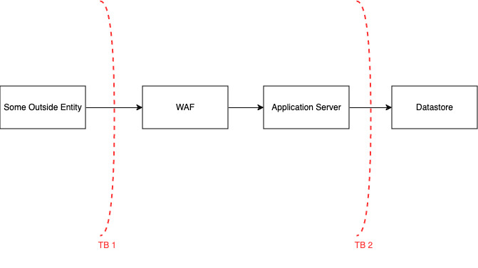
What are we working on?
Notes:
Completed in draw.io but you could have also done this on a whiteboard, with a deck of cards or using an application that focuses on Threat Modeling. There are several community free products available to provide an interface with Threat Modeling.
Depending on what I am building I can structure my threat model into different layers

Slide 15
What are we working on?
Some outside entity
WAF
Application Server
Datastore
Trust Zone A
Trust Zone B
Notes:
Completed in draw.io but you could have also done this on a whiteboard, with a deck of cards or using an application that focuses on Threat Modeling. There are several community free products available to provide an interface with Threat Modeling.
Depending on what I am building I can structure my threat model into different layers

Slide 16
What are we working on?
Assets? Records Qty?
Environment?
Some outside entity
WAF
Application Server
Transit, Ports
Functions?
Datastore
Trust Zone A
Trust Zone B
Notes:
Completed in draw.io but you could have also done this on a whiteboard, with a deck of cards or using an application that focuses on Threat Modeling. There are several community free products available to provide an interface with Threat Modeling.
Depending on what I am building I can structure my threat model into different layers

Slide 17
What can go wrong?
Threats & Countermeasures Structure
Threats – Threat Actor + Scenario + Outcome
Weakness – Scenario to realize threats (Weakness or Vulnerability)
Mitigation – Closes the weakness or vulnerability

Slide 18
What can go wrong?
Threats & Countermeasures Structure
Threats – Threat Actor + Scenario + Outcome
Weakness 1 – Scenario to realize threats (Weakness or Vulnerability)
Mitigation – Closes the weakness or vulnerability
Weakness 2
Mitigation 1 OR
Mitigation 2 (multiple mitigations could be possible to close a weakness)

Slide 19
What can go wrong?
Threats & Countermeasures Structure
Threat Actor
Threat Scenario
Threats – A non privileged user + gains access to a administrative interface + and alters key security configurations
Weakness 1 – User roles and permissions are not set appropriately
Mitigation – Deploy Role Based Access Control to user profiles
Weakness 2 – Admin credentials are set to default
Mitigation 1 – Update admin credentials and enforce org password policy
Threat Outcome

Slide 20
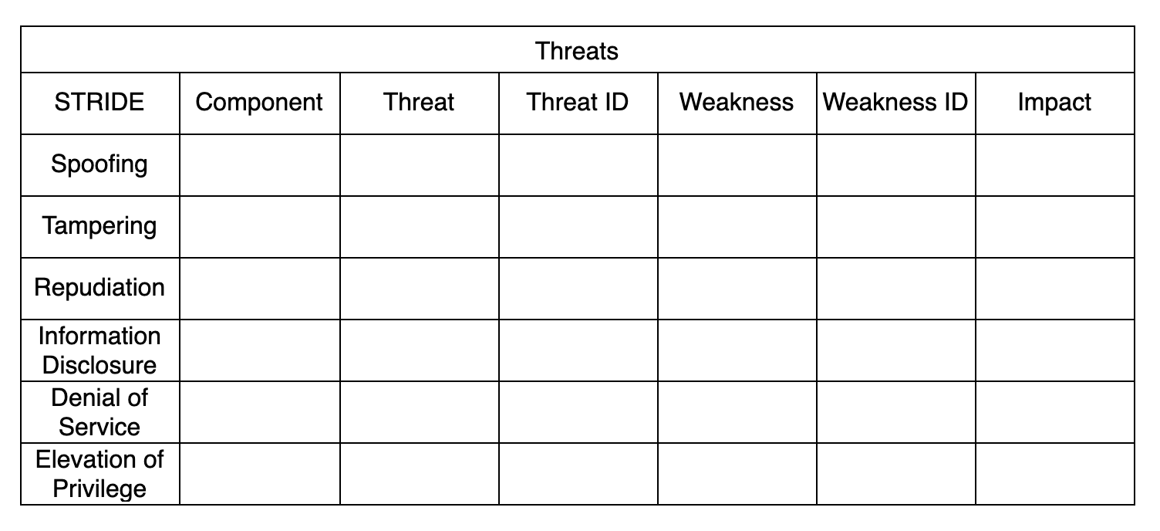
What can go wrong?
Notes:
We could have also added Threat Actor, likelihood, ease of exploit

Slide 21
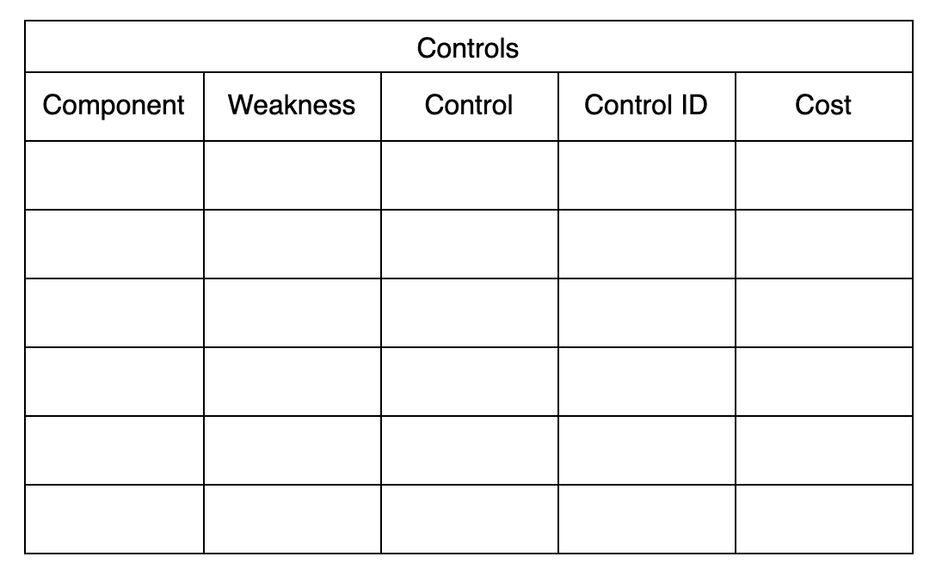
What are we going to do about it?
Notes:
We could have also added something like resource, timeline,

Slide 22

Did we do a good job?
Threat Model Completion
Do we have a plan to reduce risk?
Does that plan match our cyber risk appetite?
Have we met the expectations of key stakeholders?
Have we maximized value?

Slide 23
Freesources (Free + Resources)
Free Platform for Threat Modeling - https://community.iriusrisk.com
OWASP Threat Modeling Cheat Sheet - https://cheatsheetseries.owasp.org/cheatsheets/Threat_Modeling_Cheat_Sheet.html
World’s Shortest Threat Modeling Course - https://www.youtube.com/watch?v=2pvprvsr1lo
Threat Modeling Connect - https://threatmodelingconnect.com

Slide 24
Connect with me
James Rabe
linkedin/in/jrabe3

